Slide 1



Slide 2
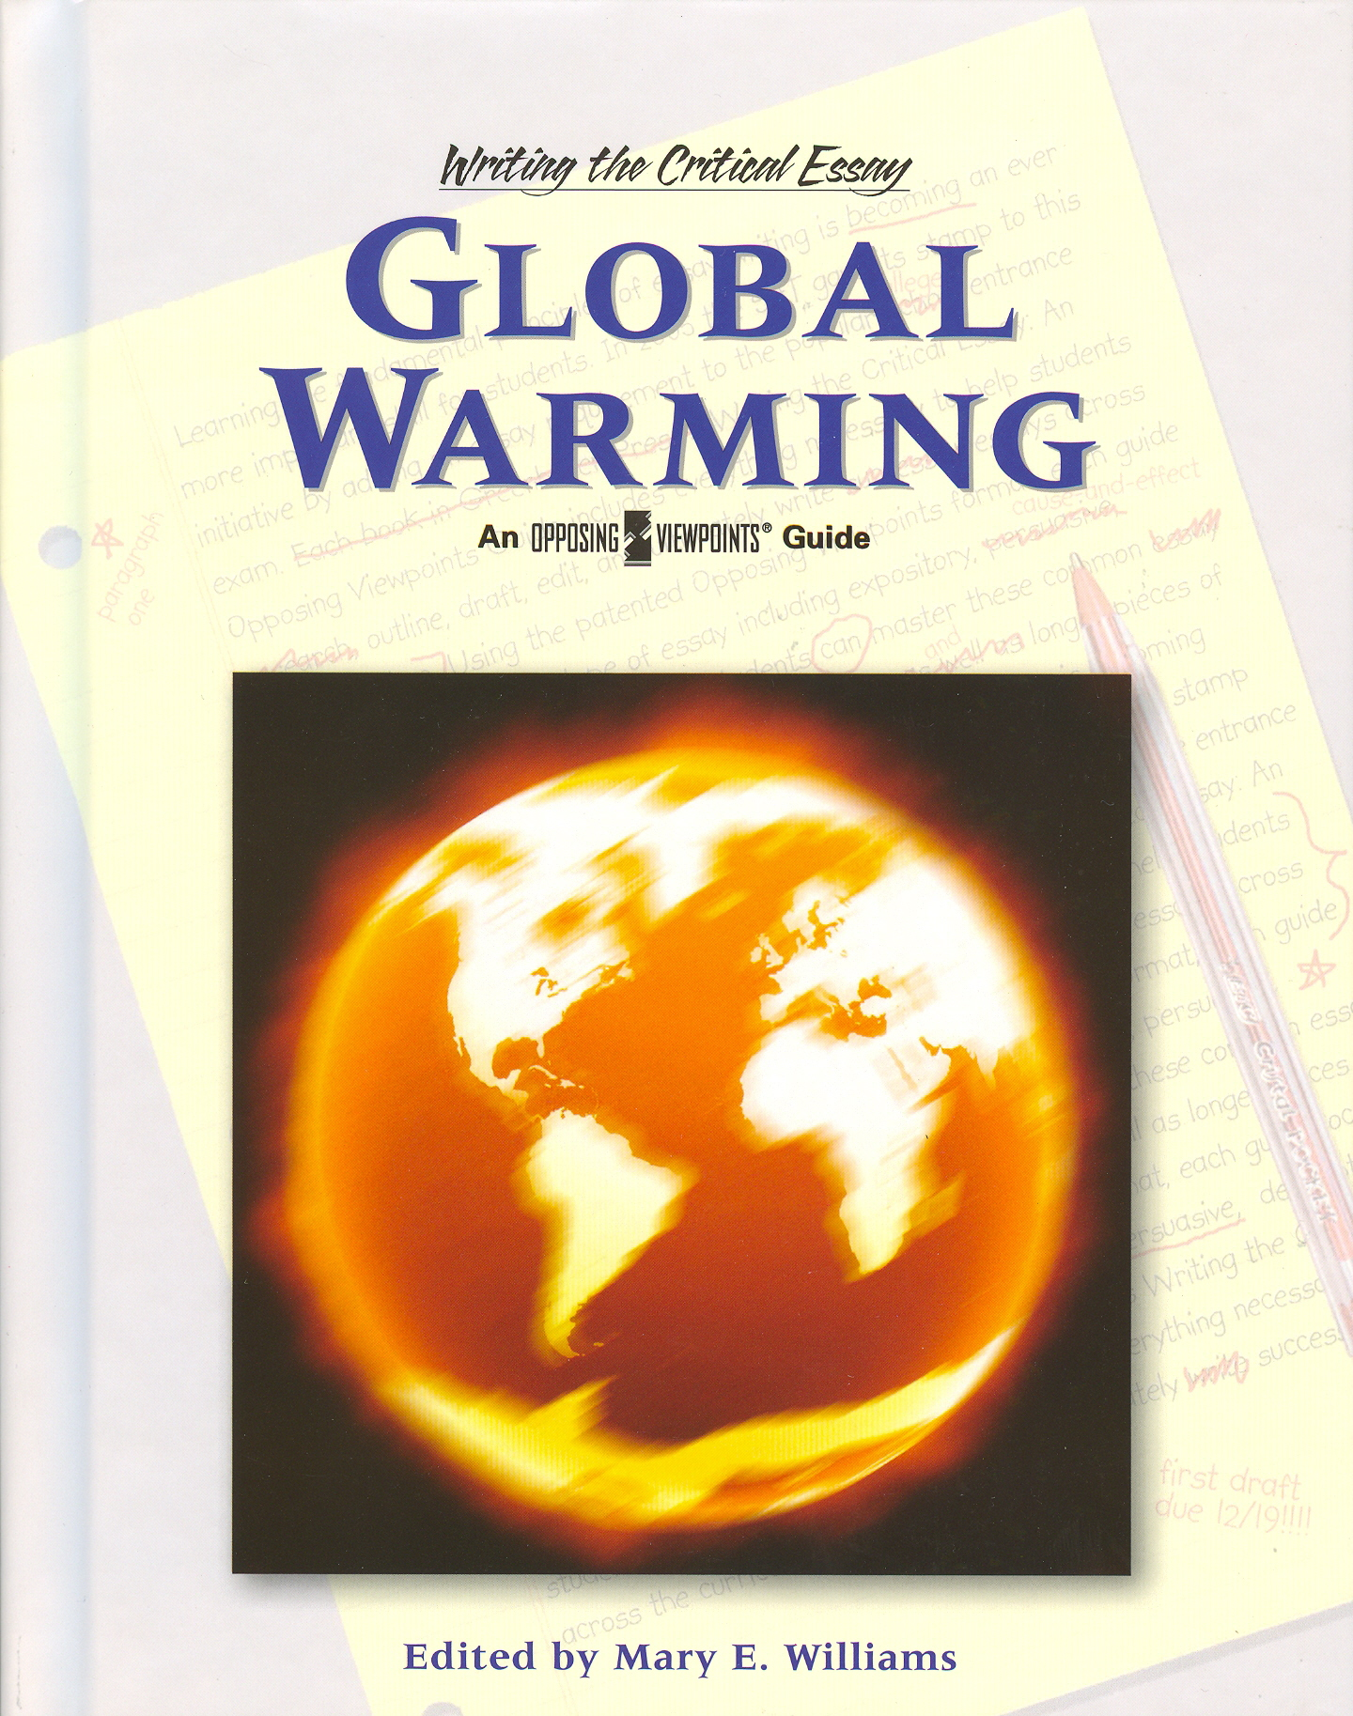
Climate Change Issues
in India
.

Slide 3
Global Warming
Global warming is the increase in the average measured temperature of the Earth's near-surface air and oceans since the mid-20th century, and its projected continuation.
The average global air temperature near the Earth's surface increased 0.74 ± 0.18 °C (1.33 ± 0.32 °F) during the 100 years ending in 2005.
Source: Intergovernmental Panel on Climate Change

Slide 4
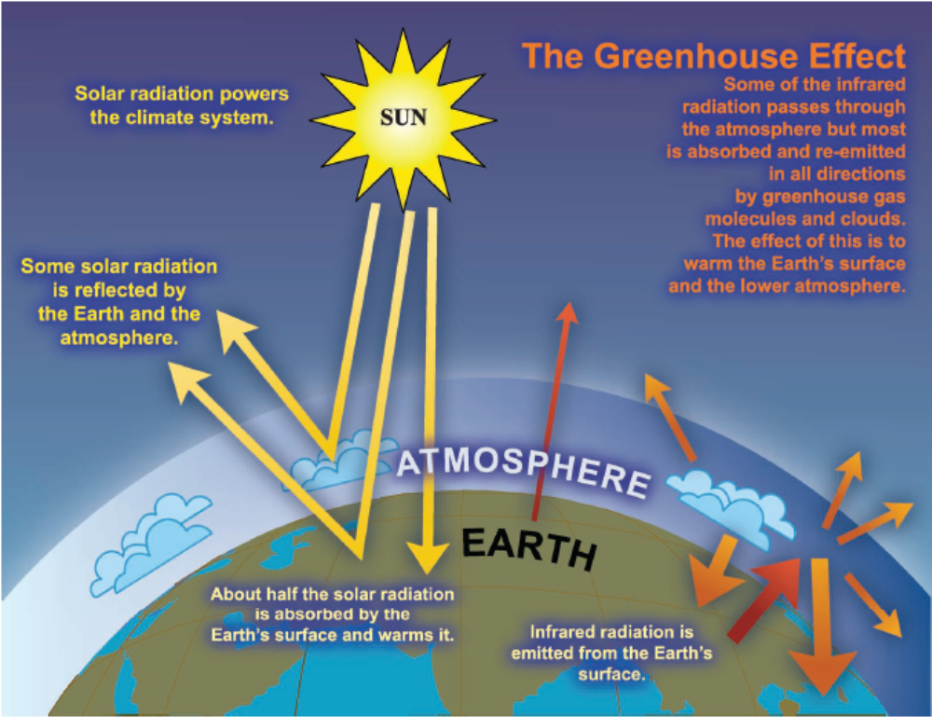
Greenhouse effect
103 Watt per m³
343 Watt per m³
240 Watt per m³
Source: Intergovernmental Panel on Climate Change

Slide 5
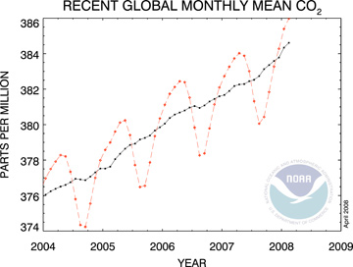
Co₂ Concentration in 2007
The 2007 rise in global carbon dioxide (CO2) concentrations is tied with 2005 as the third highest since atmospheric measurements began in 1958. The red line shows the trend together with seasonal variations. The black line indicates the trend that emerges when the seasonal cycle has been removed. (Credit: NOAA)

Slide 6
Greenhouse gases
Carbon dioxide (CO₂)
Methane (CH₄)
Nitrous oxide (N₂O)
Hydrofluorocarbons (HFCs)
Perfluorocarbons (PFCs)
Sulphur hexafluoride (SF6)
Natural
Manmade
Source: Kyoto Protocol- Annexure A

Slide 7
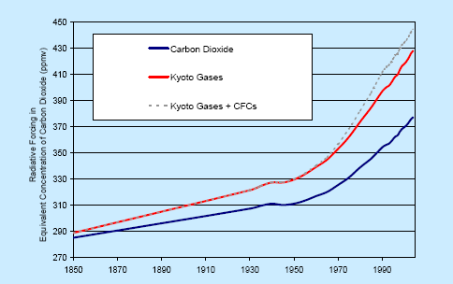
Rising levels of greenhouse gases
Source: Dr L Gohar and Prof K Shine, Dept. of Meteorology, University of Reading
Source: Stern Review

Slide 8
Impacts of Climate Change
Forests
Biodiversity
Impact of rise in temperature of 1.8ºC to 4ºC
Agriculture
Coastlines

Slide 9
Climate Change Impact in India
Rajasthan- Drought
Rann of Kutch – sea level rise
Mumbai-Salt water intrusion
Kerala –Productivity of Forest
Tamil Nadu-Coral bleaching
Ganges – Sedimentation problem
Sunderbans-Sea level raise
Northwest India-reduction In rice yield

Slide 10
Effect on apple cultivation
Case study:1 Impact on Agriculture
Kullu Valley, Himachal Pradesh
Experienced a number of crop failures in the last 15 years
Apple belt has moved 30 kilometers [northwards] over the last 50 years
Apple growers, says attributed poor production to reduced snowfall and its changed timing.

Slide 11
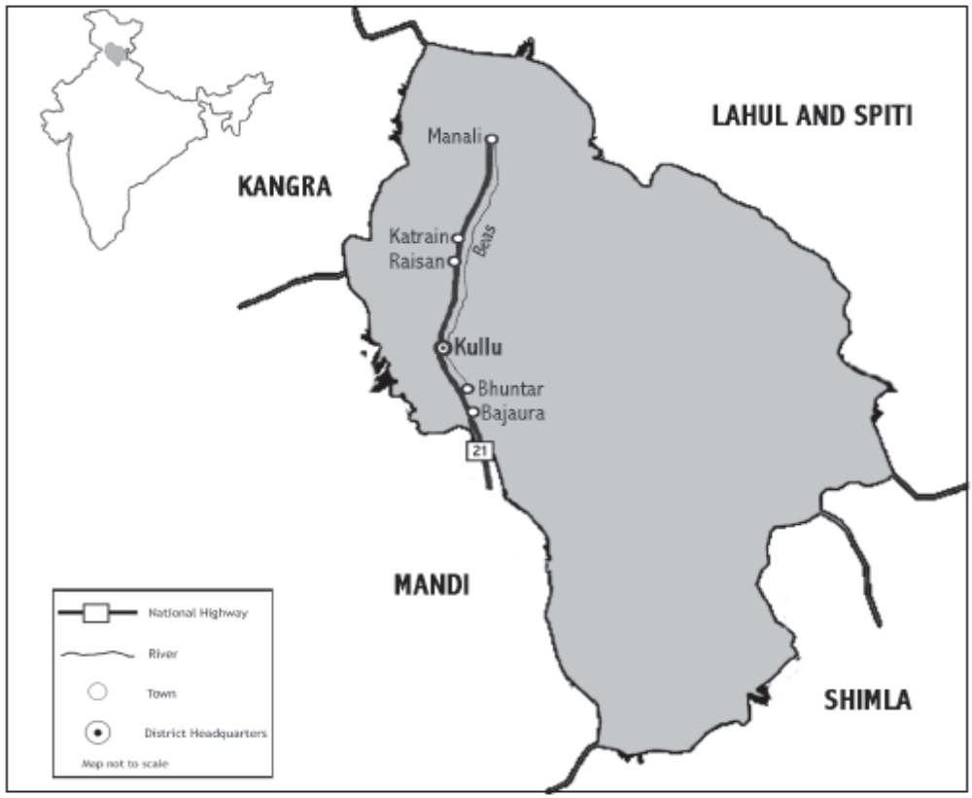
Source: Journal of Ecological Anthropology Vol. 10 2006

Slide 12
Shift in Agriculture
Apple cultivation is affected in Kullu Valley
Apple belt has moved 30 KM nothwards
Forest resources were removed

Slide 13
Global Impacts
The largest glacier on Mount Kenya has lost 92% of its mass
Sea levels have risen by 10 - 25 cm
The thickness of sea ice in the arctic has decreased by 40%.

Slide 14
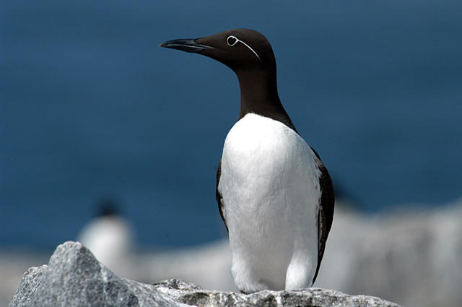
The Common Murre has advanced breeding by 24 days per decade over the past 50 years in response to higher temperatures.

Slide 15
India’s Initiatives
Signed UNFCC on 10th June 1992
India ratified the Kyoto protocol
India has a National Action Plan on Climate Change
  National Solar Mission
  National Mission for Enhanced Energy Efficiency
  National Mission on Sustainable Habitat
  National Water Mission
  National Mission for Sustaining the Himalayan Ecosystem
  National Mission for a “ Green India”
  National Mission for Sustainable Agriculture
  National Mission on Strategic Mission on Climate Change

Slide 16
India’s Initiatives
India has a well developed policy, legislative regulatory & programmatic regime
For promotion of Energy efficiency, renewable energy, nuclear power, fuel switching, energy pricing reform addressing GHG emission

Slide 17
Per-capita Carbon –dioxide emission (Metric Tons)
Country | in metric tons
USA | 20.01
Europe | 9.40
Japan | 9.87
China | 3.60
Russia | 11.71
India | 1.02
World average | 4.25

Slide 18
The impacts of climate change are not evenly distributed – the poorest countries and people will suffer earliest and most. And if and when the damages appear it will be too late to reverse the process. Thus we are forced to look a long way ahead.

Slide 19
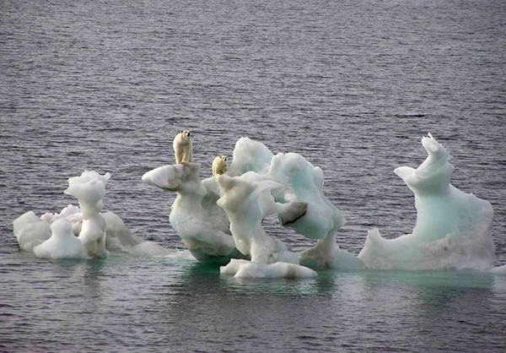
THANK YOU

